Slide 1
Ndis consultants & carers

Slide 2
A sister duo with an accounting & plan management background and lived experience as young carers and carers of NDIS participants

Slide 3
Self Management
Direct Control: You have full control over your budget and how it is spent.
Financial Management: You handle all the payments to service providers, keep track of your spending, and manage your budget.
Record Keeping: You are responsible for keeping all the necessary records and documentation.
Provider Choice: You can choose any NDIS-registered provider or even non-registered providers, giving you a broader range of choices.
Flexibility: It offers more flexibility in how you use your funding, as long as it aligns with your plan goals and guidelines.

Slide 4
Plan Management
Financial Administration: A plan manager handles all the financial tasks, such as paying invoices from service providers and managing budgets.
Record Keeping: They keep track of expenses and ensure that all transactions are recorded accurately.
Provider Choice: You can still choose your service providers, but the plan manager will handle the payments.
Support and Advice: Plan managers can provide advice on how to best use your funding and help with understanding the NDIS processes.
NDIS Funding: Plan management funding is included in your plan, and it covers the costs associated with managing your plan.

Slide 5
NDIA Managed
Financial Administration: The NDIA pays invoices directly to registered NDIS providers.
Record Keeping: The NDIA handles all record-keeping and financial tracking.
Provider Choice: You can only use NDIS-registered providers.
Support: The NDIA provides support through their portal and customer service, but you have less flexibility compared to the other management options.

Slide 6
Key Responsibilities
Budget Management: Keeping track of your spending is crucial. Regularly review your budget to ensure you’re staying within your allocated funds and making the most out of your plan.
Record Keeping: Maintain detailed records of all transactions, including invoices and receipts. This will help you with financial tracking and reporting to the NDIS.
Service Provider Management: Research and select providers who are suitable for your needs. Communicate clearly with them about your expectations and service agreements.
Compliance: Ensure that all services and supports comply with NDIS guidelines and quality standards.

Slide 7
Goals & spending
Spending should always be related back to the participants primary disability and plan goals. Goals are central to the planning process and help guide the allocation of funding and resources.
Personal Goals
Social and Community Participation
Education and Employment
Independent Living
Skill Development

Slide 8
Budget Management
Request Schedule of Service from your providers at commencement of services for duration of plan
My Solas interactive budgeting tool
Review spending monthly
Don’t forget to budget for variable expenses – report writing, travel, public holidays, shadow shifts etc.

Slide 10
Compliance – Reasonable & Necessary
The support will help to reach the goals in your NDIS plan
The support is reasonably priced and good value.
We can afford the support within the support budget
The support will help to connect with community and improve the relationships you have with family and friends
The support is something that should be funded by the NDIS and not other government services
The support is safe
The support relates to the participant's disability

Slide 11
Record Keeping
Accounting software
Diaries & schedulers
Bookkeeping

Slide 12
Service Provider Management
Plan navigator – My Solas
Expos
Community Centre
Word of mouth
May & Tay carer training and connection days

Slide 14
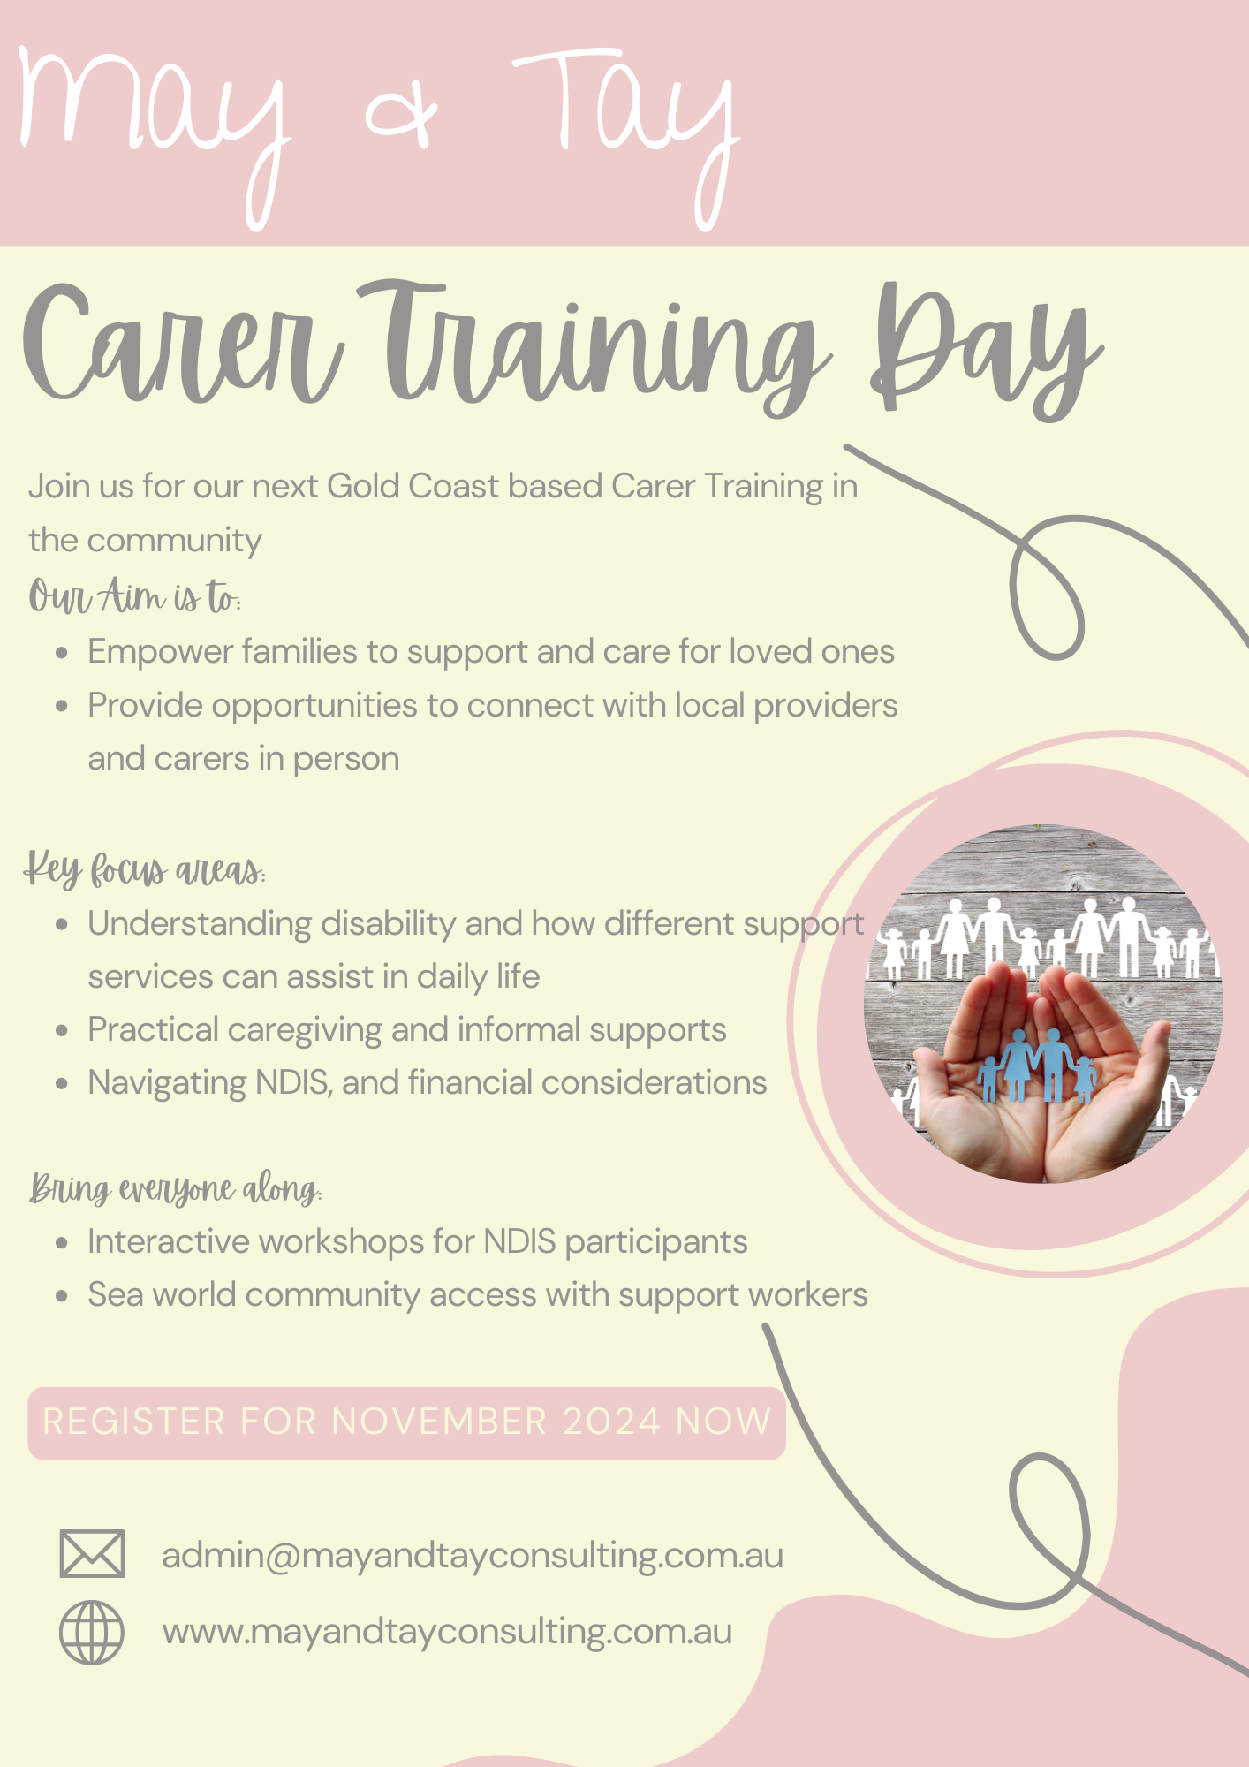
Carer Training Days
Community connections for carers & participants to link with services providers and connect to community
Anchored Care – In home supports & SIL
Oasis Services – Community Access & Transport
Hiya Health – OT & Physiotherapy
Adapted Minds – Key workers & Lead Practitioners
May & Tay – Self Management

